Slide 1
Shell Bootcamp 2024 – TECHNICAL FOUNDATION Reflections for Day 1 (29-Aug-2024)
Hitesh
Date : 30-Aug-2024

Slide 2

My learnings from this week!

Slide 3

Learning 1 | My takeaways
Introduction to Business Analysis
Definition: According to the International Institute of Business Analysis (IIBA), business analysis is the practice of enabling change within an organizational context.
Business: An organization that provides products or services to satisfy customer needs with the objective of making a profit.
Analysis: A systematic examination.
SDLC Model (Software Development Life Cycle)
Planning: Involves business analysts to define requirements.
Design and Prototyping
Software Development
Testing
Deployment
Operations and Maintenance
Requirement Analysis
Definition: The process of defining user expectations for a new or modified software.
Types:
Functional Requirements: Describe what the product does (mandatory).
Non-Functional Requirements: Describe how the product works (non-mandatory).
Key Learning: Never assume; always ask. This was emphasized through a team activity where we modelled a paper airplane.
Requirement Elicitation
Definition: The practice of researching and discovering the requirements of a system from users, customers, and other stakeholders. Also known as “requirement gathering.”

Slide 4
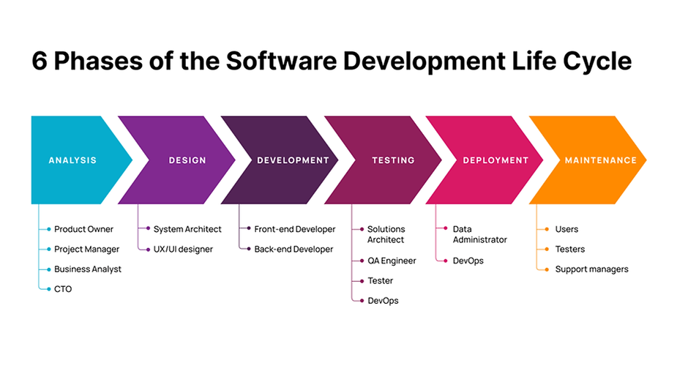
Learning 1 | My takeaways

Slide 5
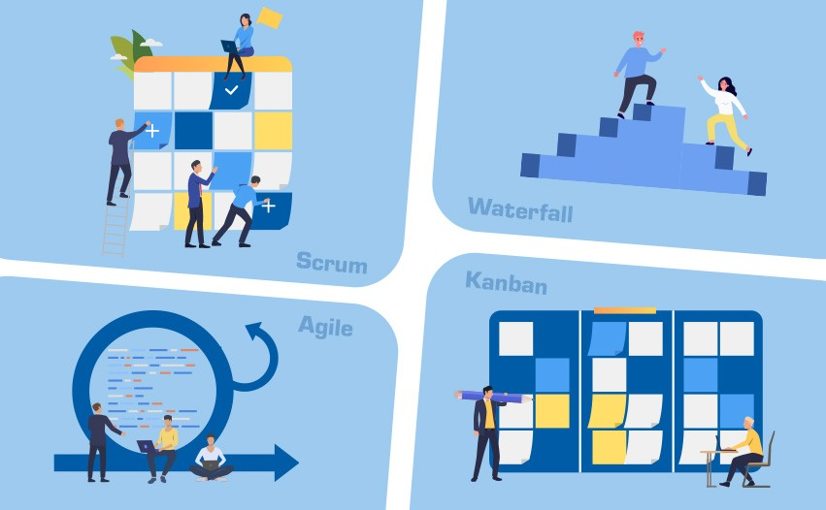
Learning 2 | My takeaways
Top Techniques:
Brainstorming
Document Analysis
Requirement Modelling
Types:
Class-Based
Data-Based
Top Management Techniques
Work Breakdown Structure (WBS): Essential for effective project planning, execution, controlling, monitoring, and reporting.
Gantt Charts
Critical Path Method
Waterfall Model
Kanban
Scrum
Requirement Traceability: Ensures each business need is tied to an actual requirement and each requirement is tied to a deliverable.

Slide 6
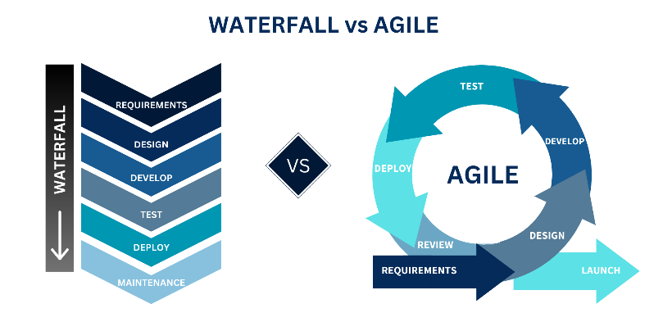
Learning 3 | My takeaways
Waterfall Model
Stages: Requirements, Design, Development, Testing, Deployment, Maintenance.
Advantages: Simple, easy to understand, good for small requirements, and works well when quality is more important than cost or schedule.
Disadvantages: Cannot go back to previous stages, customers see the product only at launch, no demos involved.
When to Use the Waterfall Model?
Requirements are well-known.
Product definition is stable.
Technology is understood.
Developing a new version of an existing product.
Porting an existing product to a new platform.
Agile Methods
Examples: Adaptive Software Development, Feature Driven Development, Scrum, Extreme Programming, Kanban.
Benefits of Scrum
Adaptability, continuous improvement, sustainable pace, motivation, faster problem resolution, customer-centric, high velocity, efficient development process.

Slide 7
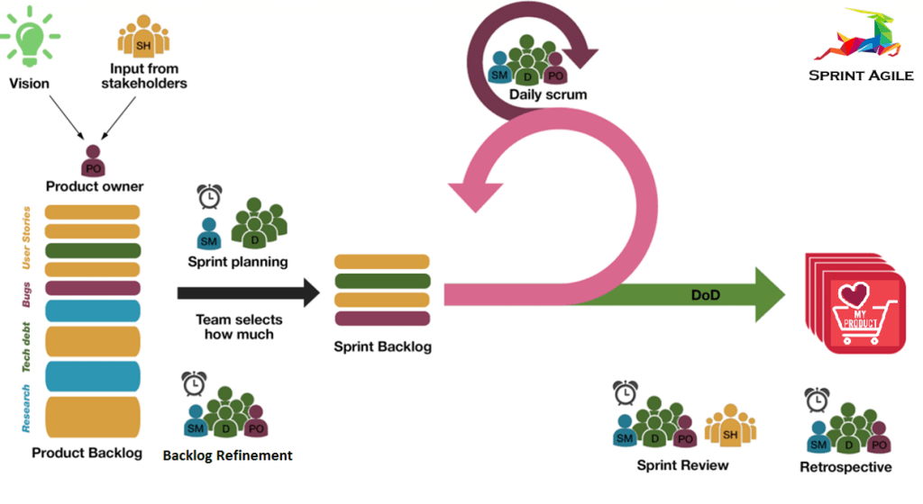
Learning 4 | My takeaways
Scrum Flow
Sprint: A 2–4-week period to accomplish a goal.
Roles:
Product Owner
Scrum Master
Scrum Team Members
Stakeholders
Daily Scrum: A 15-minute daily meeting to review progress.
Sprint Retrospective: A meeting at the end of each sprint to review achievements and plan improvements.
Scrum Events
Sprint Planning: Deciding what can be delivered within a sprint and what work is needed.
Daily Scrum: Reviewing progress toward the sprint goal.
Sprint Review: Reviewing achievements at the end of each sprint and adapting the product backlog if needed.
Sprint Retrospective: Inspecting the team’s performance and creating a plan for improvements.

Slide 8
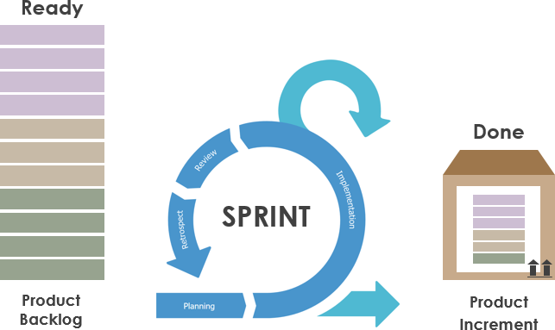
Learning 5 | My takeaways
Product Backlog for Planning
Project planning is based on a product backlog containing functions and technology enhancements.
Meetings:
To decide features for the next sprint.
To plan out the work.
Scrum Queues
Uses lightweight queue-based management and work breakdown mechanisms.
The Sprint
Definition: The basic unit of development in Scrum.
Duration: One week to one month.
“Time-Boxed”: Effort of a constant length.
Setting Up Azure DevOps
Details on setting up and using Azure DevOps for project management and development.

Slide 9
Thank You

